Slide 1
SPRING
Introduction

Slide 2
Jakarta EE
Java Platform - Enterprise Edition
Java EE, aka Jakarta EE, is the name of Oracle's Java platform for enterprise applications.
In 2018, Oracle handed over the project to the Eclipse Foundation, and it took on the name Jakarta EE as chosen by the development community.

Slide 3
What's it about?
Web application development
Intended for companies
Java-based: robust and portable
Deployed and executed on an application server

Slide 4
Specifications
JEE is not a framework.
It is a set of specifications. Prior to version 5, making a JEE project was long and complex it:
required adding and configuring many libraries
featured slow deployment on servers

Slide 5




Application server
Application Server
Customer
HTTP Server
Web
Container
HTTP
Request
Apache Tomcat : Tomcat is a web server. Because it’s very lightweight, Tomcat dominates the server market.
HTTP Response
The Web Container retrieves HTTP requests, interprets them, and generates dynamic content, which it then converts into HTTP and returns.

Slide 6
Client / Server Exchanges
HTTP Request
URL: page to access
HTTP methods :
GET: data retrieval (URL settings)
POST: sending data (form for example)
HTTP Response
Status code :
200: success
404: page not found
500: server error
Content-type: type of content, e.g. text, picture, html
Content: static content

Slide 7


Spring
Too complex
2003
"Spring takes care of the "plumbing" of applications [...], so that teams can focus more on [...] business logic [...]"

Slide 8




How? How?
Spring Core :
IoC and DI
Spring Boot
Spring REST
Spring Data JPA
And many others: https://spring.io/projects

Slide 9

JARS
=
From the
hundreds
of JARs
(Java Archives)
To avoid integrating these manually into a Java project, we use a dependency manager
Include
mvn dependency:tree
in a Spring project
to take a closer look

Slide 10
Maven
Maven is an open-source project building tool which was developed by the Apache Foundation.
Specifically, it helps with:
the automation of certain tasks i.e.: compilation, unit testing and the deployment of applications
managing dependencies to the libraries used within the project
generating documentation for the project

Slide 11


Spring Boot
=
pom.xml
Generated
by Spring Boot
"Recipe" for building the project
Spring Boot
A project
ready to be executed
Configured by Spring Initializr

Slide 12
Annotations
Component
class Wilder {
// ...
}
Spring is going to
detect the class
(i.e. so that it can generate the associated bean and inject it elsewhere)
Repository
class WilderDAO {
// ...
}
Service
WilderService class {
// ...
}
Controller
class WilderController {
// ...
}
https://www.baeldung.com/spring-bean-annotations

Slide 13
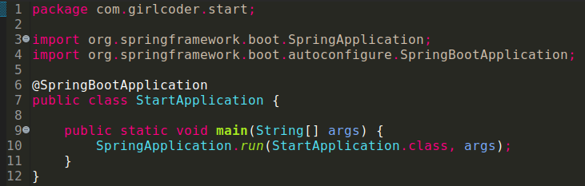
Create an application
We create the "main" class:
to act as the ignition of the application
to ensure there is a step before the packages
containing the other classes
EnableAutoConfiguration
Configures the app according to the dependencies (JARs)
ComponentScan
Finds all classes marked "@Component"
+
+
...

Slide 14
Add a static file
File hello.html in src/main/resources/static
<!DOCTYPE html>
< html lang="en" >
< head>
< meta charset="UTF-8" >
< title>Title</title>
</head>
< body>
< h1>Hello World! </h1>>
</body>
</html>
Compile and run the application using: mvn spring-boot:run
The page will be accessible at the following url: http://localhost:8080/hello.html

Slide 15
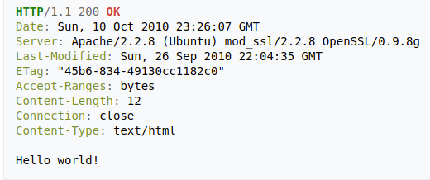
Create a route that displays text (or JSON)
Controller
Create a controller
@GetMapping
Controller
public class MyController {
@GetMapping("/hello/say")
ReplyBody
public String sayHelloWorld() {
return "Hello World!";
}
}
This is equivalent to:
@RequestMapping(method = RequestMethod.GET)
ReplyBody
Display the text "Hello World!" If an object is returned, Spring Boot will transform it into JSON

Slide 16
Create a route that calls a page
Inside the controller
Controller
Controller
public class MyController {
@GetMapping("/hello")
public String showHelloPage() {
return "/hello.html";
}
}
@GetMapping
This is equivalent to:
@RequestMapping(method = RequestMethod.GET)
Opens the hello.html page

Slide 17
Questions?

Slide 18
Workshop

Slide 19
Workshop
Create a project with Spring Initializr:
Group: en.wcs
Artifact: introSpring
Dependencies: Web
Open the project in the IDE and then create a “WildController”, that contains everything we will need to display content when a URL is called.
Now create a method that displays the text "Introduction to Spring" when the "/workshop" path is called. Create an "index.html" file and save it to the right place, so that the text: “See the content of the workshop" links to the "/workshop" path. During compilation and execution:
the content of index.html must appear on http://localhost:8080
the workshop path should appear if you follow the relevant link,

